Slide 1
Compensation
Lecture 13

Slide 2
Define the concept of competency based pay

Slide 3
Competency based Pay
Competencies
Demonstrable characteristics of a person, including knowledge, skills, and behaviors, that enable performance
Competency-based pay means the company pays for the employee’s range, depth, and types of skills and knowledge, rather than for the job title he or she holds. Experts variously call this competency-, knowledge-, or skill-based pay.
Competency-based pay ties the worker’s pay to his or her competencies—pay is more person oriented. Employees here are paid based on what they know or can do—even if, at the moment, they don’t have to do it.
Traditional pay plans may backfire if a high-performance work system (HPWS) is the goal. HPWS employees must be enthusiastic about learning and moving among other jobs.

Slide 4
Why Use Competency-Based Pay?
Competency-Based Pay Supports
High-Performance Work Systems
Strategic Aims
Performance Management

Slide 5
Competency-Based Pay: Pros and Cons
Pros
Higher quality
Lower absenteeism
Fewer accidents
Cons
Pay program implementation problems
Costs of paying for unused knowledge, skills, and behaviors
Complexity of program
Uncertainty that the program improves productivity

Slide 6
What are Exempt/Non Exempt?

Slide 7
Who Is Exempt? Who Is Not Exempt?
Exempt Professionals
Attorneys
Physicians
Dentists
Pharmacists
Optometrists
Architects
Engineers
Teachers
Certified public accountants
Scientists
Computer systems analysts
Exempt Executives
Corporate officers
Department heads
Superintendents
General managers
Individual who is in sole charge of an “independent establishment” or branch
Exempt Administrators
Executive assistant to the president
Personnel directors
Credit managers
Purchasing agents
Nonexempt
Paralegals
Non licensed accountants
Accounting clerks
Newspaper writers
Working foreman/forewoman
Working supervisor
Lead worker
Management trainees
Secretaries
Clerical employees
Inspectors
Statisticians
Note: These lists are general in nature, and exceptions exist. Any questionable allocation of exemption status should be reviewed by labor legal counsel.
Source: Jeffrey Friedman, “The Fair Labor Standards Act Today: A Primer,” Compensation, January/February 2002, p. 53.

Slide 8
Equity and its Impact on Pay Rates

Slide 9
Equity and Its Impact on Pay Rates
The equity theory of motivation
States that if a person perceives an inequity, the person will be motivated to reduce or eliminate the tension and perceived inequity.

Slide 10
Forms of Equity
External equity
How a job’s pay rate in one company compares to the job’s pay rate in other companies.
Internal equity
How fair the job’s pay rate is, when compared to other jobs within the same company
Individual equity
How fair an individual’s pay as compared with what his or her co-workers are earning for the same or very similar jobs within the company.
Procedural equity
The perceived fairness of the process and procedures to make decisions regarding the allocation of pay.

Slide 11
Methods to Address Equity Issues
Salary surveys
To monitor and maintain external equity.
Job analysis and job evaluation
To maintain internal equity,
Performance appraisal and incentive pay
To maintain individual equity.
Communications, grievance mechanisms, and employees’ participation
To help ensure that employees view the pay process as transparent and fair.

Slide 12
Establishing Pay Rates

Slide 13
Establishing Pay Rates
Steps in Establishing Pay Rates
1
Conduct a salary survey of what other employers are paying for comparable jobs (to help ensure external equity).
2
Determine the worth of each job in your organization through job evaluation (to ensure internal equity).
3
Group similar jobs into pay grades.
4
Price each pay grade by using wave curves.
5
Fine-tune pay rates.
Notes:
The process of establishing pay rates while ensuring external, internal, and (to some extent) procedural equity consists of five steps.

Slide 14
Step1: The Salary Survey
Uses for Salary Surveys
To price benchmark jobs
To market-price wages for jobs
To make decisions about benefits
Notes:
It’s difficult to set pay rates if you don’t know what others are paying, so salary surveys of what others are paying play a big role in pricing jobs. Virtually every employer conducts at least an informal telephone, newspaper, or Internet salary survey.

Slide 15
Sources for Salary Surveys
Sources of Wage and Salary Information
Self-Conducted Surveys
Consulting Firms
Professional Associations
Government Agencies
The Internet
Notes:
Salary surveys can be formal or informal. Informal phone or Internet surveys are good for checking specific issues. Some large employers can afford to send out their own formal surveys to collect compensation information from other employers. Many employers use surveys published by consulting firms, professional associations, or government agencies.

Slide 16
Step 2: Job Evaluation
Identifying Compensable Factors
Skills
Effort
Responsibility
Working conditions
Notes:
Job evaluation is a formal and systematic comparison of jobs to determine the worth of one job relative to other jobs in the organization.
Compensable factors are certain basic factors the jobs have in common that are used to establish how the jobs compare to one another, and that determine the pay for each job.

Slide 17
How to Evaluate Jobs
Methods for Evaluating Jobs
Ranking
Job classification
Point method
Factor comparison
Notes:
Evaluating the worth of each job can be done using one of these methods: ranking, job classification, point method, or factor comparison.

Slide 18
Step 3: Grouping Jobs
Point Method
Grouping Similar Jobs into Pay Grades
Ranking Method
Classification Methods
Notes:
Once the committee has used job evaluation to determine the relative worth of each job, it can turn to the task of assigning pay rates to each job; however, it will usually want to first group jobs into pay grades using one of these three methods. A pay grade is comprised of jobs of approximately equal in difficulty or importance as established by job evaluation.

Slide 19
Step 4: Price Each Pay Grade
The Wage Curve
Shows the pay rates paid for jobs in each pay grade, relative to the points or rankings assigned to each job or grade by the job evaluation.
Shows the relationships between the value of the job as determined by one of the job evaluation methods and the current average pay rates for your grades.
Notes:
The wage curve shows the pay rates currently paid for jobs in each pay grade, relative to the points or rankings values assigned to each job or grade by the job evaluation.

Slide 20
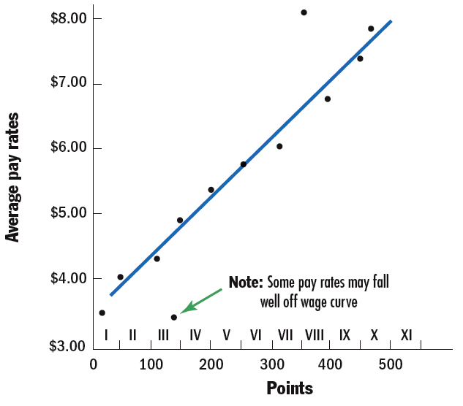
FIGURE 11–5 Plotting a Wage Curve
Notes:
The wage curve shows the pay rates currently paid for jobs in each pay grade, relative to the points or rankings assigned to each job or grade by the job evaluation. The purpose of the wage curve is to show the relationships between (1) the value of the job as determined by one of the job evaluation methods and (2) the current average pay rates for graded jobs.
Figure 11-5 presents an example. Note that it shows pay rates on the vertical axis, and pay grades (in terms of points) along the horizontal axis.
The pay rates on the wage curve are traditionally those now paid by the employer. However, if there is reason to believe the current pay rates are out of step with the market rates for these jobs, choose benchmark jobs within each pay grade, and price them via a compensation survey. These new market-based pay rates then replace the current rates on the wage curve. Then slot in your other jobs (and their pay rates) around the benchmark job.
Current pay rates falling above the rate range are “red circle,” “flagged,” or “overrates” which will require either freezing the rate, transfer or promotion of employees, or reevaluation of the job.

Slide 21
Step 5: Fine-Tune Pay Rates
Developing Pay Ranges
Flexibility in meeting external job market rates
Easier for employees to move into higher pay grades
Allows for rewarding performance differences and seniority
Correcting Out-of-Line Rates
Raising underpaid jobs to the minimum of the rate range for their pay grade
Freezing rates or cutting pay rates for overpaid (“red circle”) jobs to maximum in the pay range for their pay grade
Notes:
Fine-tuning involves (1) developing pay ranges and (2) correcting out-of-line rates.

